Slide 1
Diaconate – (the office of deacon, or a person’s tenure of it – a body of deacons collectively)
The Make- up and Role of the Deacon’s Ministry (Diaconate) @
The New Bethel MB Church

Slide 2
The Deacon Must Know and Participate in the Mission of the Church
What is the Mission and Vision of The New Bethel Missionary Baptist Church?

Slide 3
OUR MISSION & VISION
The Plan, The Purpose, and The Program of this body of believers is to meet the mandate and Commission of God the Father, as outlined in the Word of God and inspired by the HOLY SPIRIT. Our mission is to be an empowered church, operating in the spirit of excellence to fulfill the Great Commission. Matthew 28:18-20
The New Bethel Missionary Baptist Church envisions a spiritually Healthy Church, and we stand ready for action in that we have the 3 A’s: *A Desire to Teach *A Continuing preparation to teach and *An Audience who wants to be taught. We desire to be a spiritually healthy local church body. Through a spiritually balanced diet, giving equal importance to Five New Testament Categories:
Evangelism – Worship – Christian Education – Discipleship – Mission

Slide 4
Ways of Evangelizing or Sharing the Good News
1. The Romans Road Approach

Slide 6
Memory Scriptures – The Romans Road
The Potential for Salvation – Romans 1:16 For I am not ashamed of the gospel, because it is the power of God that brings salvation to everyone who believes: first to the Jew, then to the Gentile.
2. The Population of Sinners – Romans 3:10, 23 ¹⁰ As it is written: “There is no one righteous, not even one. ²³ for all have sinned and fall short of the glory of God,
3. The Problem of and Pay for Sin – Romans 6: 23 For the wages of sin is death, but the gift of God is eternal life in Christ Jesus our Lord.
4. The Presentation and Plan of Salvation - Romans 10:8-10, 13 ⁸ But what saith it? The word is nigh thee, even in thy mouth, and in thy heart: that is, the word of faith, which we preach; ⁹ That if thou shalt confess with thy mouth the Lord Jesus, and shalt believe in thine heart that God hath raised him from the dead, thou shalt be saved. ¹⁰ For with the heart man believeth unto righteousness; and with the mouth confession is made unto salvation. ¹³ For whosoever shall call upon the name of the Lord shall be saved.

Slide 7
3 Things Every Deacon Ought to Do
Know that you are Saved.
1
Know how to communicate to others how to become saved.
2
Participate in the Call to Discipleship INTENTIONALLY
3

Slide 8
The Office of the Deacon (1 Timothy 3:8-13)
Verse 8 He is DESCRIBED as GRAVE.
Honest. Worthy of respect. Serious man of dignity. Not showy
HE IS DESCRIBED as one who is NOT DOUBLE TONGUED.
Tells a different story based on who’s listening.
NOT GIVEN TO MUCH WINE.
He is cautious about the amount of wine/alcohol intake.

Slide 9
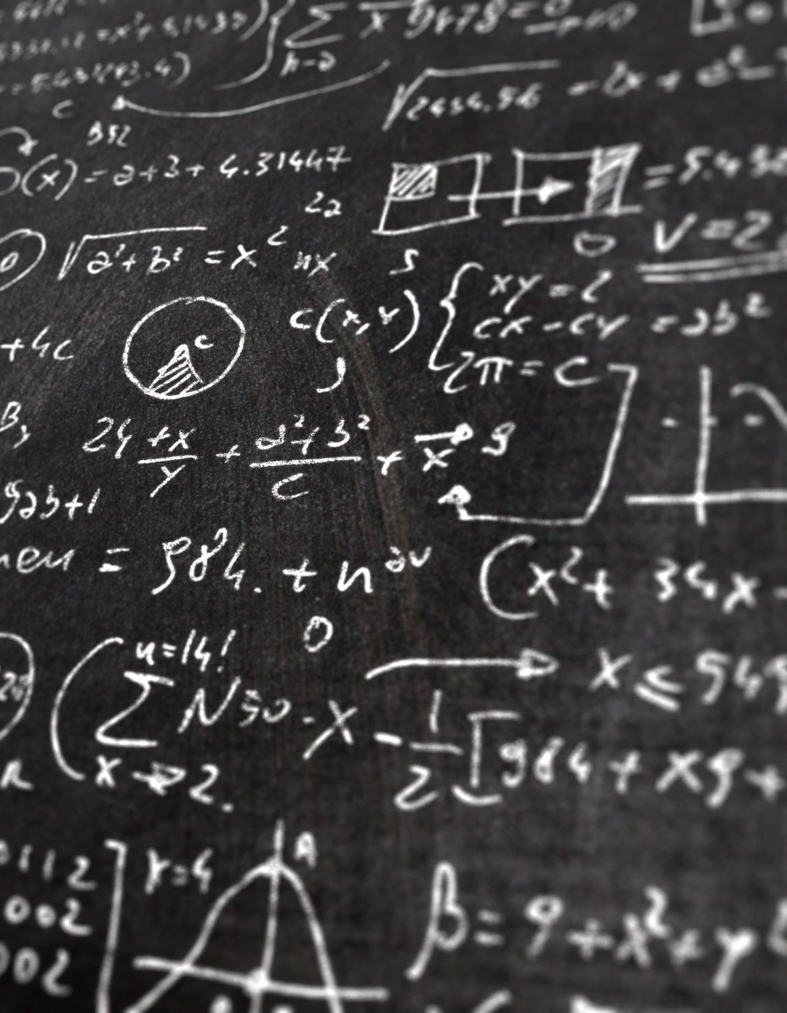
The Office of the Deacon (1 Timothy 3:8-13)
Verse 9 it is said that THE DEACON HOLDS THE MYSTERY OF FAITH IN A PURE CONSCIOUS – A man of spiritual depth and whose theology matches his professional life.

Slide 10
The Office of the Deacon (1 Timothy 3:8-13)
In Verse 10 – the deacon must first be PROVED – tested and examined.
He must occupy the office of a deacon BLAMELESS. His personal practices ought not be questionable.

Slide 11
The Office of the Deacon (1 Timothy 3:8-13)
Verse 11 says that his wife must also be GRAVE. An honest and a woman of dignity.
His wife must NOT BE a SLANDERER. A false accuser, too talkative about non- spiritual matters.

Slide 12
The Office of the Deacon (1 Timothy 3:8-13)
Verse 12 says that He must be THE HUSBAND OF ONE WIFE. He must have only one living wife. This text is not addressing divorce ad much as it is addressing Polygamy – The practice or custom of having more than one wife at the same time.
He must RULE HIS CHILDREN AND HOUSE WELL – Does the deacon manage his own home adequately (money, order, testimony, etc.)

Slide 13
The Office of the Deacon (1 Timothy 3:8-13)
Verse 13 says he must PURCHASE TO THEMSELVES A GOOD DEGREE OF AND GREAT BOLDNESS IN THE FAITH - Deacons must commit to spiritual growth for the purpose of spiritual strength and boldness for the faith.

Slide 14
The Work of the Diaconate/Deacon
The Deacon Must Know and Participate in the Mission of the Church
The Deacon Must Know how to and Commit to Prayer.

Slide 15
How to Pray

Slide 16
The ACTS of Prayer (Matthew 6:9-13) Personal and Group/Corporate
Adoration - Worship
Confession – to agree with GOD (Know 1 John 1:9)
Thanksgiving - Gratitude (Know Philippians 4:6)
Supplication – Petitioning God for others and self.
Psalm 4:1
Psalm 5:8
James 1:5
Ephesians 6:18

Slide 17
The Work of the Diaconate/Deacon
The Deacon Must Know and Participate in the Mission of the Church
1
The Deacon Must Know how to and Commit to Prayer.
2
The Deacon Must Practice Ethics in Ministry
3

Slide 18
He ought to know the Values or the Statement of Faith of Baptist ARTICLES OF FAITH The Articles of Faith which should be adopted by Baptist churches at the time of organization:
I. THE SCRIPTURES
We believe that the Holy Bible was written by men divinely inspired, and is a perfect treasure of heavenly instruction; that it has God for its author, salvation for its end, and truth without mixture of error for its matter; that it reveals the principles by which God will judge us; and therefore is, and shall remain to the end of the world, the true center of Christian union, and the supreme standard by which all human conduct, creeds, and opinions are tried. II timothy 3:16-17, II Peter1:21
II. THE TRUE GOD
We believe the Scriptures teach that there is one, and only one, living and true God, an infinite, intelligent Spirit, whose name is JEHOVAH, the MAKER and SUPREME RULER OF HEAVEN and EARTH; inexpressibly glorious in holiness, and worthy of all possible honor, confidence and love; that in the unity of the Godhead there are three persons, the Father, the Son, and the Holy Ghost equal in every divine perfection, and executing distinct but harmonious offices in the great work of redemption. John 4:24, Hebrews 3:4

Slide 19
He ought to know the Values or the Statement of Faith of Baptist ARTICLES OF FAITH The Articles of Faith which should be adopted by Baptist churches at the time of organization:
III. THE FALL OF MAN
We believe the Scriptures teach that man was created in holiness, under the law of his Maker; but by his voluntary transgression fell from that holy and happy state; in consequence of which all mankind are now sinners, not by constraint but choice; being by nature utterly void of that holiness required by the law of God, positively inclined to evil; and therefore under just condemnation to eternal ruin, without defense or excuse. Genesis 1:27, Genesis 3:6-24, Romans 5:12
IV. THE WAY OF SALVATION
We believe the Scriptures teach that the salvation of sinners is wholly of grace; through the mediatorial offices of the Son of God; who by the appointment of the Father, freely took upon him our nature, yet without sin; honored the divine law by His personal obedience, and by his death made a full atonement for our sins; that having risen from the dead, He is now enthroned in heaven; and uniting in His wonderful person the tenderest sympathies with divine perfections, He is every way qualified to be suitable, a compassionate and all-sufficient Savior. Ephesians 2:5, I John 4:10
V. OF JUSTIFICATION
We believe the Scriptures teach that the great Gospel blessing which Christ secures to such as believe in Him is justification; that justification includes the pardon of sin, and the promise of eternal life on principles of righteousness; that it is bestowed, not in consideration of any works of righteousness which we have done, but solely through faith in the Redeemer’s blood; by virtue of which faith His righteousness is freely imputed to us of God, and secures every other blessing needful for time and eternity. Acts 13:39, Romans 5:9

Slide 20
He ought to know the Values or the Statement of Faith of Baptist ARTICLES OF FAITH The Articles of Faith which should be adopted by Baptist churches at the time of organization:
VI. THE FREENESS OF SALVATION
We believe that the scriptures teach that the blessings of salvation are made free to all by the Gospel; that it is the immediate duty of all to accept them by cordial, penitent and obedient faith; and that nothing prevents the salvation of the greatest sinner on earth; but his own determined depravity and voluntary rejection of the Gospel; which rejection involves him in an aggravated condemnation. Luke 13:5, Romans 6:17-22
VII. OF REGENERATION
We believe the Scriptures teach that in order to be saved, sinners must be regenerated, or born again; that regeneration consists in giving a holy disposition to the mind that it is effected in a manner above our comprehension by the power of the Holy Spirit in connection with divine truth, so as to secure our voluntary obedience to the Gospel; and that its proper evidence appears in the holy fruits of repentance and faith, and newness of life. John 3:6, I Peter 1:23
VIII. OF REPENTANCE AND FAITH
We believe the Scriptures teach that repentance and faith are sacred duties, and also inseparable graces, wrought in our souls by the regenerating Spirit of God; whereby being deeply convinced of our guilt, danger and helplessness and of the way salvation by Christ, we turn to God with unfeigned contrition, confession, and supplication for mercy; at the same time heartily receiving the Lord Jesus Christ as our prophet, priest and king, and relying on him alone as the only and all-sufficient Savior. Matthew 4:17, II Corinthians 5:7

Slide 21
He ought to know the Values or the Statement of Faith of Baptist ARTICLES OF FAITH The Articles of Faith which should be adopted by Baptist churches at the time of organization:
IX. GOD’S PURPOSE OF GRACE
We believe the Scriptures teach that election is the eternal purpose of God, according to which He graciously regenerates, sanctifies and saves sinners; that being perfectly consistent with the free agency of man, it comprehends all the means in connection with the end; that it is a most glorious display of God’s sovereign goodness, being infinitely free, wise, holy and unchangeable; that it utterly excludes boasting, and promotes, humility, love, prayer, praise, trust in God, and active imitation of His free mercy; that it encourages the use of means in the highest degree; that it may be ascertained by its effects in all who truly believe the Gospel; that it is the foundation of Christian assurance; and that to ascertain it with regard to ourselves demands and deserves the utmost diligence. 2 Timothy 1:8-9, II Thessalonians 2:13-14
X. SANCTIFICATION
We believe the Scriptures teach that sanctification is the process by which according to the will of God, we are made partakers of His Holiness: that it is a progressive work; that it is begun in regeneration; that it is carried on in the hearts of believers by the presence and power of the Holy Spirit, The Sealer and Comforter, in the continual use of the appointed means—especially the Word of God, self-examination, self-denial, watchfulness, and prayer; and in the practice of all godly exercises and duties. I Thessalonians 4:3-8, II Corinthians 7:1
XI. THE PERSEVERANCE OF THE SAINTS
We believe the Scriptures teach that such only are real believers as endure to the end; that their persevering attachment to Christ is the grand mark which distinguishes them from superficial professors; that a special Providence watches over their welfare; and they are kept by the power of God through faith unto salvation. John 6:39, John 8:31

Slide 22
He ought to know the Values or the Statement of Faith of Baptist ARTICLES OF FAITH The Articles of Faith which should be adopted by Baptist churches at the time of organization:
XII. THE LAW AND THE GOSPEL
We believe the Scriptures teach that the Law of God is the eternal and unchangeable rule of His moral government; that it is holy, just and good; and that the inability which the Scriptures ascribe to fallen humanity to fulfill its precepts arise entirely from their love of sin; to deliver them from which, and to restore them through a Mediator to unfeigned obedience to the Holy Law, is one great end of the Gospel, and of the Means of Grace connected with the establishment of the visible Church. Romans 3:31, Matthew 5:17
XIII. A GOSPEL CHURCH
We believe the Scriptures teach that a visible Church of Christ is a congregation of baptized believers, associated by covenant in the faith and fellowship of the Gospel; observing the ordinances of Christ; governed by His laws; and exercising the gifts, rights, and privileges invested in them by his words; that its only scriptural officers are Bishops or Pastors, and Deacons, whose qualification, claims, and duties are defined in the Epistles of Timothy and Titus. Acts 2:41, Acts 2:47
XIV. BAPTISM AND THE LORD’S SUPPER
We believe the Scripture teach that Christian Baptism is the immersion in water of a believer in Christ, into the name of the Father, and Son, and Holy Ghost; to show forth, in a solemn and beautiful emblem, our faith in the crucified, buried, and risen Savior, with its effect, in our death to sin and resurrection to a new life; that it is prerequisite to the privileges of a church relation, and to the Lord’s Supper, in which the members of the church by the sacred use of bread and wine, are to commemorate together the dying love of Christ; precede always by self-examination. Acts 8:36-39, I Corinthians 11:23-28

Slide 23
He ought to know the Values or the Statement of Faith of Baptist ARTICLES OF FAITH The Articles of Faith which should be adopted by Baptist churches at the time of organization:
XV. THE CHRISTIAN SABBATH
We believe the Scriptures teach that the first day of the week is the Lord’s Day; or Christian Sabbath, and is to be kept sacred to religious purposes, by abstaining from all secular labor and sinful recreations, by devout observance of all the means of grace, both private and public; and by preparation for that rest that remains for the people of God. Acts 20:7, Genesis 2:3
XVI. CIVIL GOVERNMENT
We believe the Scripture teach that civil government is of divine appointment, for the interest and good order of human society; and that magistrates are to be prayed for, conscientiously honored and obeyed, except only in things opposed to the will of our Lord Jesus Christ, who is the only Lord of the conscience, and the Prince of the kings of the earth. Romans 13:1-7, I Peter 2:13
XVII. RIGHTEOUS AND WICKED
We believe the Scriptures teach that there is a radical and essential difference between the righteous and the wicked; that such only as through faith are justified in the name of the Lord Jesus, and sanctified by the Spirit of our God, are truly righteous in His esteem; while all such as continue in impenitence and unbelief are, in His sight, wicked and under the curse; and this distinction holds among persons both in this life and after death. Malachi 3:18, Romans 6:16

Slide 24
He ought to know the Values or the Statement of Faith of Baptist ARTICLES OF FAITH The Articles of Faith which should be adopted by Baptist churches at the time of organization:
XVIII. THE WORLD TO COME
We believe the Scriptures teach that the end of the world is approaching; that at the Last Day, Christ will descend from heaven, and raise the dead from the grave for final retribution; that a solemn separation will then take place; that the wicked be judged to endless sorrow, and the righteous to endless joy; and this judgment will fix forever the final state of men in heaven or hell, on principles of righteousness. 1 Peter 4:7, I John 2:17

Slide 25
What are the Values of The Christian/Disciple of Christ
Colossians 3:1-6 (“Since then, you have been raised with Christ, set your hearts on things above, where Christ is seated at the right hand of God. Set your minds on things above, not on earthly things. For you died, and your life is now hidden with Christ in God. When Christ, who is your life, appears, then you also will appear with him in glory. Put to death, therefore, whatever belongs to your earthly nature: sexual immorality, impurity, lust, evil desires and greed, which is idolatry. Because of these, the wrath of God is coming.”)
1 Corinthians 6:19-20 tells us how to manage our bodies.
Romans 13:1 – tells us how we ought to respond to civil authorities.
John 14:26- tells us that when we study the Bible The Holy Spirit will remind us of what is right and what is wrong.

Slide 26
The Work of the Diaconate/Deacon
The Deacon Must Know and Participate in the Mission of the Church
The Deacon Must Know how to and Commit to Prayer.
The Deacon Must Practice Ethics in Ministry
4. The Deacon Must Know that He is to ASSIST not BOSS the Pastor.

Slide 27
Conduct in Business Decisions - “Deacon Run Churches” Are They Biblical?

Slide 28
Biblical References (The Governance of the local Church.)
Acts 6
Called to Serve
1 Timothy 3
2 officers of the church (Pastors /Elders & Deacons)
What is the code of conduct for Christians?
The Ten Commandments are the Christian's code of conduct that separates us from the rest of the world and serves as a barometer of our allegiance to the Creator of the universe. Ten Commandments: The Christian Code of Conduct examines the commandments of God and how they apply to the Christian life.

Slide 29
The Work of the Diaconate/Deacon
The Deacon Must Know and Participate in the Mission of the Church
The Deacon Must Know how to and Commit to Prayer.
The Deacon Must Practice Ethics in Ministry
4. The Deacon Must Know that He is to ASSIST not BOSS the Pastor.
5. The Deacon Must Know how Important it is to COMMIT to KNOWING AND STUDYING THE BIBLE.

Slide 30
“The Bible”
How to Study the Bible Allen Parr

Slide 31
BASIC BIBLE KNOWLEDGE
Synonyms – The Word, the Scriptures, the Writings The Divisions Old Testament (Hebrew Scriptures)
The Order of the Bible Law History Wisdom Major Prophets Minor Prophets
3. New Testament (Christian Scriptures) Gospels History Pauline Epistles General Epistles Revelation
Longest / shortest scriptures
Study Methods Daily Topical Biographical Book-by-Book Memorization / Recitation
Versions of the Bible
King James Version (1611)
New King James Version (1982)
New International Version (1978)

Slide 32
The Wisdom of Others:
Case Study #1
A single mother with four children began attending our services.
It became clear very quickly that she had severe financial problems, and several people in the church proposed that we try to help her. It was the philosophy of that church that historically church deacons had given aid in exactly these circumstances. So the deacons visited her and offered to give her church funds for several months to help her pay off outstanding bills. She happily accepted.
Three months later it came out that, instead of paying her bills with the money we had been giving her, she had spent it on sweets and junk food, had gone out to restaurants with her family multiple times, and had bought each child a new bike. Not a single bill had been paid, and she needed more money.
What would you do?

Slide 33
The Wisdom of Others:
The Three Tables of the Church
The Poor/ The Preacher/ The Church
The 2 Ordinances (things we must do) of the Church
Communion
Baptism

