Slide 1
My Small Group
November 17th -24th

Slide 2
Group Participants
Toby – Group Leader
Flora
Sonjia
Tyrone

Slide 3
Being A Disciple
Describe the first time you heard about God. ______________________
Describe the first time you prayed to God. _____________________________
Describe a time that God may have been present and active in your life, but you didn’t recognize it at the time._____________________________

Slide 4
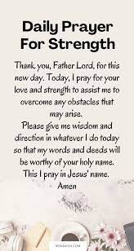

Slide 5
Introduction – Ways The Bible describes becoming SAVED or Conversion which simply means we have been or can be forgiven for our sins. We do this by making a decision to leave our old ways behind and begin to trust God for eternal life.
New Creation
Saved
Born again
Redeemed
New Creation
Saved
Born again
Redeemed

Slide 6
2 Corinthians 5:17 -Therefore, if anyone is in Christ, he is a new creation. The old has passed away (God wipes the slate clean); behold, the new has come (He gives us a new slate). 17 This means that anyone who belongs to Christ has become a new person. The old life is gone; a new life has begun!
What new things do you hope Jesus will bring to your life?
________________________________________________________________________________________________________________________________________________________________________________________________________________________________________________________________________________________

Slide 7
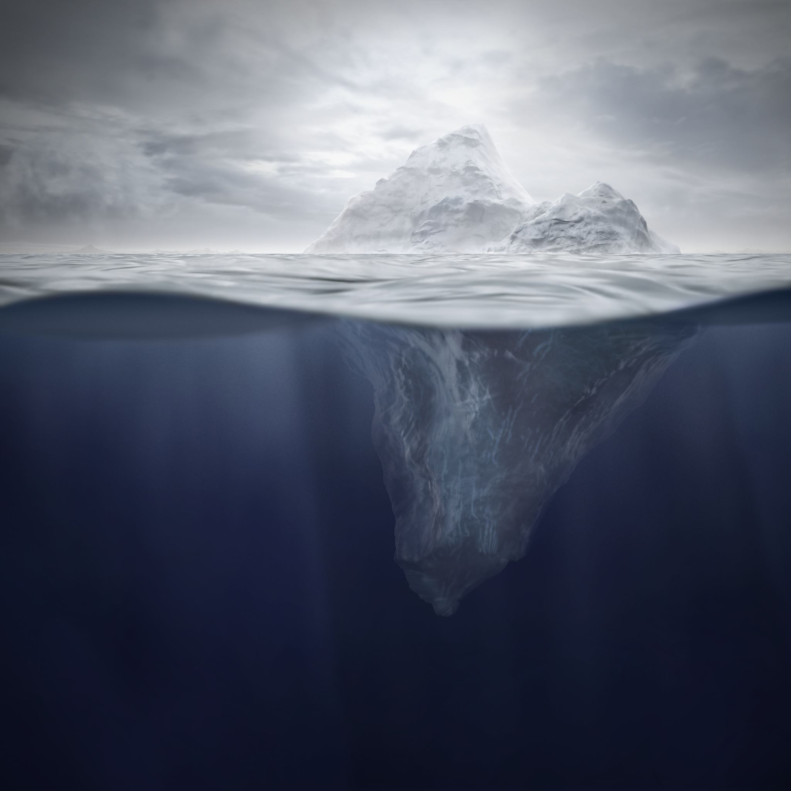
Luke 5:4-11
The main idea of Luke 5:4-11 is that Jesus calls Simon Peter and his companions to follow him, demonstrating his power by miraculously filling their nets with fish after a fruitless night of fishing, causing Peter to recognize his own sinfulness and readily leave everything to follow Jesus as a "fisher of men."

Slide 8
What are some practical examples of what it will look like to follow Jesus in your life? ______________________________________________________
What will make it difficult to follow Jesus? ______________________________________________________ In what ways will it be easy?

Slide 9
Have you ever the thought about “The Story of the Bible”?
There is the CREATION of man.
Then there was the Fall of man.
God’s Plan of REDEMPTION.
Jesus’s ability to provide RECREATION.

Slide 10
Philippians 2:5-11- helps us understand what it means to follow Jesus. List in the spaces the attributes and actions of Jesus that His followers should imitate

Slide 11
Philippians 2:5-11
⁵ In your relationships with one another, have the same mindset as Christ Jesus:
⁶ Who, being in very nature God, did not consider equality with God something to be used to his own advantage; rather, he made himself nothing by taking the very nature of a servant, being made in human likeness. ⁸And being found in appearance as a man, he humbled himself by becoming obedient to death— even death on a cross!
⁹ Therefore God exalted him to the highest place and gave him the name that is above every name, ¹⁰ that at the name of Jesus every knee should bow, in heaven and on earth and under the earth, ¹¹ and every tongue acknowledge that Jesus Christ is Lord, to the glory of God, the Father.
__________________________________________________________________________________________________________________________________________________________________________________________________________________________________________________________________________________________________________________________________________________________________________________________________________________________________________________________________________________________________________________________________________________________________________________________________________________________________________________________________________________________________________________________________________________________________________________________________________________________________________________________________________________________________________________________________________________________________________________

Slide 12
Mark 1-4 (Reading Assignment for the Week)
Mark 1-4 of the Bible introduces John the Baptist, Jesus' baptism, and the calling of the first four disciples:
John the Baptist
God's messenger who prepared the world for the Messiah by baptizing people who wanted to change their lives and align with God's will. John's baptism was a sign of repentance and forgiveness, and it taught people that they needed to turn from their sins.
Jesus' baptism
Jesus' baptism signaled the coming of God's fulfillment and the need for people to recognize their Savior.
Calling of the disciples
Mark briefly notes the calling of the first four disciples.
Jesus' teaching and healings
After being baptized, Jesus began teaching in the synagogue and performing miraculous healings that spread his fame.
Mark 4
In Mark 4, Jesus uses parables to explain why people react the way they do. He also explains that the softer a person's heart is, the more truth God will reveal

Slide 13
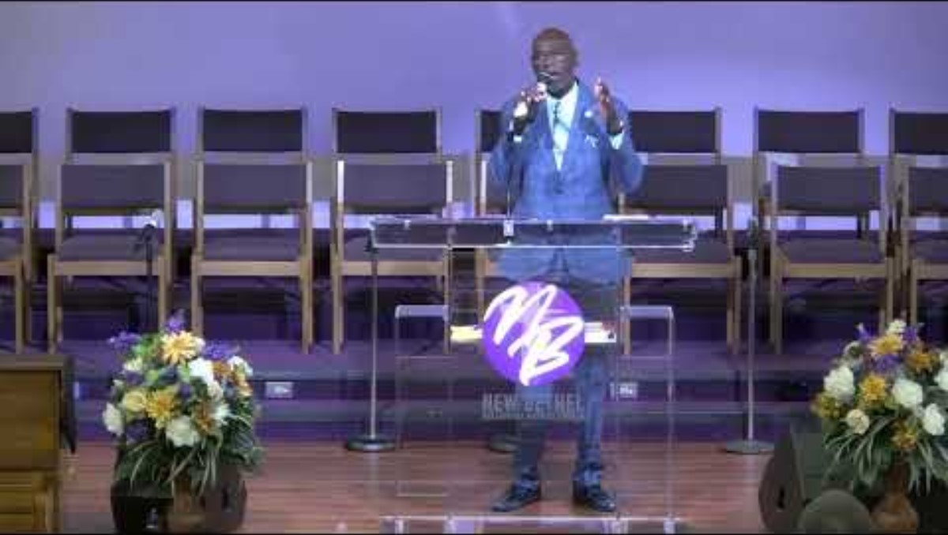
Listen to Pastor’s Sermon from Sunday “How & Why, Jesus Came”

Slide 14
Task to Consider
Connect with your church or a local church and attend a worship service.
Seek someone who you think would be good for this small bible study group.
Memorize 2 Corinthians 5:17
Take notes “write down questions and thoughts”.

