Slide 1

THE STORY
The Disciples Path series was created by disciple-makers for disciple-makers. We recruited 14 disciple-making church leaders to think through how to instill the doctrines, biblical understandings, principles, and practices of discipleship with the end of making disciples who would make disciples.
The experts did much more than simply define the principles and practices that would be utilized. They determined the studies to create, the sessions to include, and the format to use. And, to ensure consistency and to preserve the passion,
The outcome is a series of studies that, when used as suggested, is a powerful tool in the hands of anyone willing to disciple another believer.

Slide 2



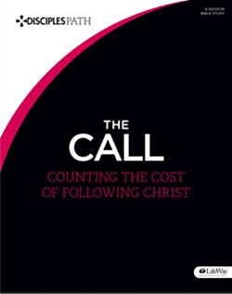



TAKE THE NEXT STEP

Slide 3
THE BEGINNING
CONTENTS
A NOTE FOR DISCIPLE MAKERS
WHAT IS A DISCIPLE
HOW TO USE THIS RESOURCE
SESSION 1 WHAT JUST HAPPENED
SESSION 2 THE CENTRALITY OF CHRIST
SESSION 3 TIME WITH JESUS
SESSION 4 THE BLESSING OF COMMUNITY
SESSION 5 JOINING JESUS ON MISSION
LEADER INSTRUCTIONS

Slide 4
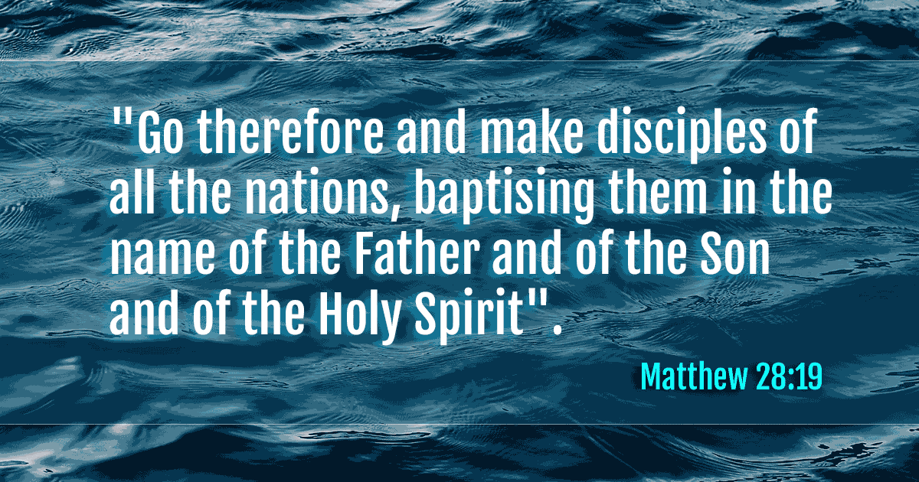
A NOTE FOR DISCIPL MAKERS

Slide 5
MATTHEW 28:19
DISCIPLESHIP IS THE PRIMARY GOAL OF CHRISTIANS
“The disciples path series is a simple tool, no for making disciples but for enabling all of us to take hold of and obey Jesus’ great, enduring commission.”

Slide 6
WHAT IS A DISCIPLE?
ONE WHO HAS CHOSEN TO FOLLOW JESUS
HIS COMMAND TO HIS FIRST RECRUITS WERE FOLLOW ME
LUKE 6:40 The student is not above the teacher, but everyone who is fully trained will be like their teacher.

Slide 7

1 John 3:1 See what great love the Father has lavished on us, that we should be called children of God! And that is what we are! The reason the world does not know us is that it did not know him.
A CHILD OF GOD
1 Peter 2:11 Dear friends, I urge you, as foreigners and exiles, to abstain from sinful desires, which wage war against your soul.
AN ALIEN IN THIS WORLD
2 Cor. 5:17,20 Therefore, if anyone is in Christ, the new creation has come: The old has gone, the new is here! (20) We are therefore Christ’s ambassadors, as though God were making his appeal through us. We implore you on Christ’s behalf: Be reconciled to God.
AN AMBASSADOR FOR CHRIST

Slide 8

YOUR SMALL GROUP
GET STARTED
GROUP DISCUSSION
PRAY TOGETHER AND REFLECT ON LESSON SHARED BY PASTOR
  THE STORY (FOLLOW QUESTIONS FOR DISCUSSION)
    KNOW THE STORY
    UNPACK THE STORY
  ENGAGE – GROUP ACTIVITY PROVIDED BY PASTOR

Slide 9
INDIVIDUAL DISCOVERY
WEEKLY ACTIVITIES
WORSHIP
PERSONAL STUDY
APPLICATION (READING PLAN)

Slide 10
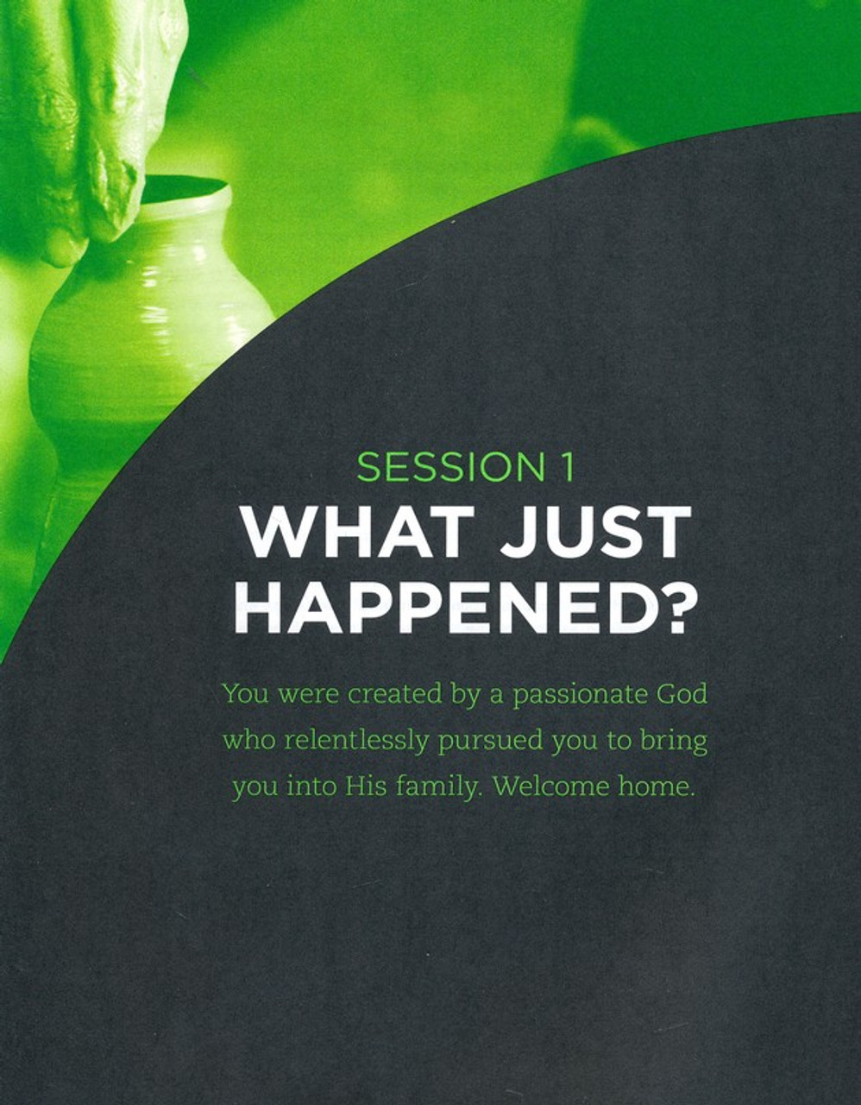
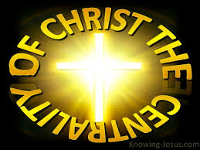

Slide 11
Lesson Introduction:
THE BIBLE USES A CONSTRUCTION ANALOGY TO DESCRIBE FOLLOWERS OF CHRIST. (EPH. 2:19-22)
¹⁹ Consequently, you are no longer foreigners and strangers, but fellow citizens with God’s people and members of his household, ²⁰ built on the foundation of the apostles and prophets, with Christ Jesus himself as the chief cornerstone. ²¹ In him the whole building is joined together and rises to become a holy temple in the Lord. ²² And in him you too are being built together to become a dwelling in which God lives by his Spirit.

Slide 12
Small Group – Intro Questions
What are some fears or confusions you have about “reworking our lives around a new center”?
What stands out the most as you learn about the spiritual Copernican (Christ is Center) revolution?

Slide 13
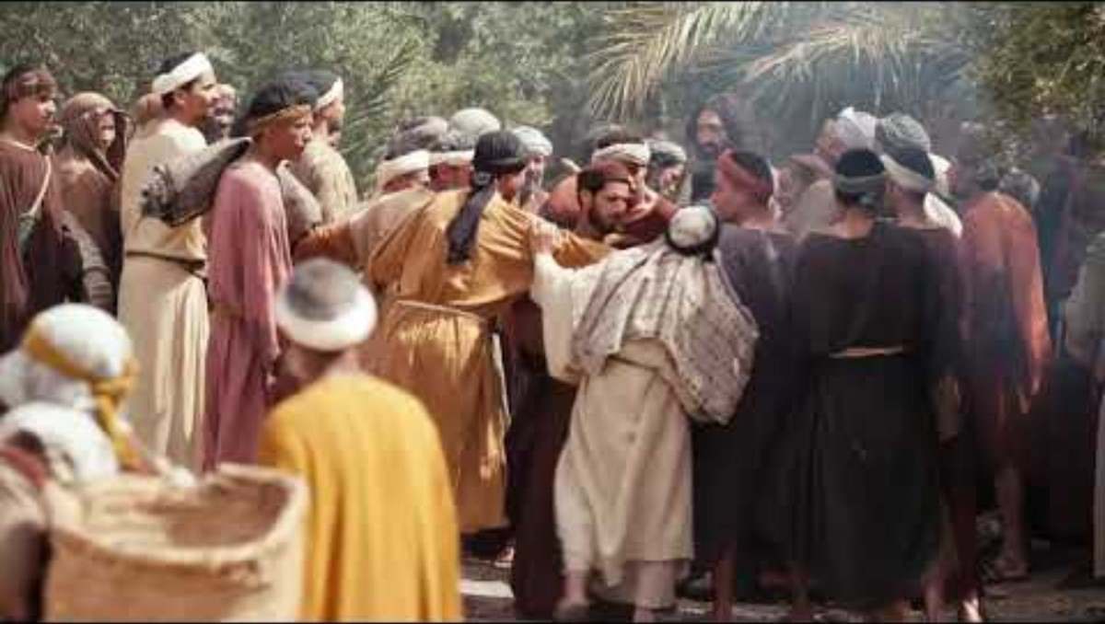
Know The Story (Luke 19:1-10)

Slide 14

Small Group – The Story Questions
What was central to your identity before you became a Christian What defined you?
(Zacchaeus was wealthy because he extorted money from people as a tax collector. But that changed when he met Jesus. Zacchaeus’s focus on money shifted (v.8) – Jesus was the new center of his life.)
2. Why do you think Zacchaeus a wealthy man by all indications would choose to give it all up to make Jesus central in his life?

Slide 15
Unpack The Story (Central to My Identity)
Zacchaeus was a hated man. For the most part, tax collectors in his time were hated men in a Jewish community for two main reasons:
1. They were notorious thieves who gained their wealth by extorting money from taxpayers. They were hated for their thievery.
2. They were also known as traitors to their culture as Roman governors would choose Jewish men as tax-collectors in Jewish regions. They were hated for betraying their ethnic community to ally with the pagan Roman Government.
Questions:
Judging from what you know about his story, what do you think Zacchaeus thought about himself before encountering Jesus?
What did Zacchaeus’s lifestyle suggest about his identity and motivation?
Zacchaeus had always been hated, but what caused Zacchaeus to change was the whole new view of himself that Jesus gave him: he was loved and accepted by Christ.
Similarly, when we become Christians, Jesus redefines us as He becomes central to our identity and our view of ourselves. For Christians, the defining moment of our lives is Jesus’ crucifixion on the cross. Everything the cross reveals about us is the most true and important information we can know about ourselves.
Question:
1. Why is it so important to understand that we are loved and accepted by Christ?

Slide 16
Unpack The Story
Central to my Identity (Central to What I Do)
Jesus must also be central to what we do.
He puts everything else in life into its proper place.
The story of Zacchaeus shows that there’s only one position Jesus will occupy in a person’s life: a central position.
Because Jesus had become central, Zacchaeus’s treatment of people and money were now taking their cues from Jesus.
Questions:
What’s the most difficult part of this realignment?
What’s the most freeing part of approaching life with this new perspective?
Take a few minutes to read Luke 18:18-23. Discuss what you think was going on in the ruler’s heart that kept him from obeying Jesus’ challenge.
Jesus saw the ruler’s heart and asked if he’d be willing to get rid of his money and reorient his entire life. The man went away sad because he didn’t want the decisions, he mad with his money to revolve around Jesus. Because his money was central, the ruler saw Jesus as secondary.

Slide 17
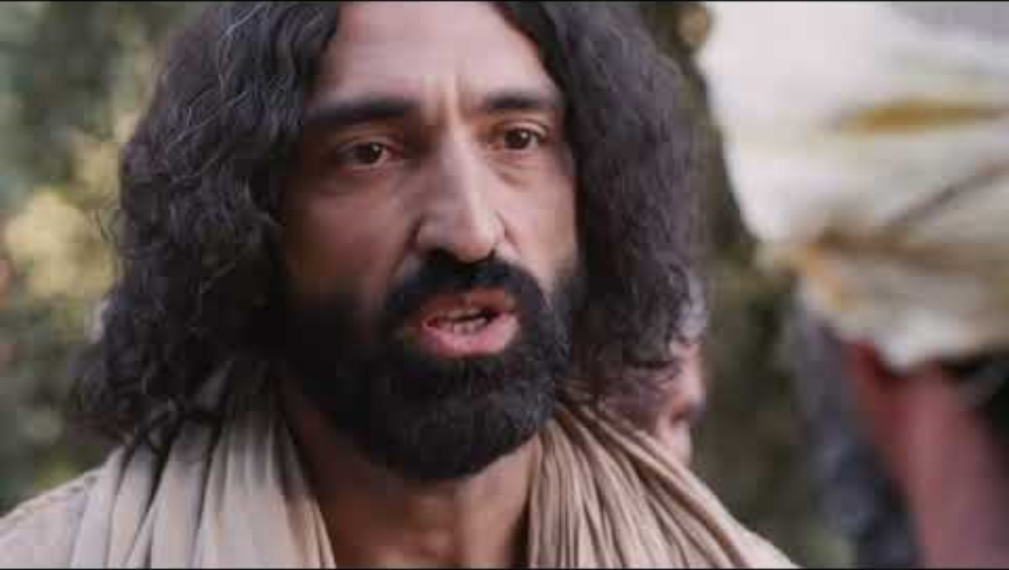
When He is not The Center; then our ACTIONS will REFLECT That LUKE 18:18-30

Slide 18
The Engaging Exercise- READ ACTS 7:54-60 AND LUKE 23:32-46 together . Circle the similarities you find between how Jesus died and how Stephen died.
Acts 7:54-60 - ⁵⁴ When the members of the Sanhedrin heard this, they were furious and gnashed their teeth at him. ⁵⁵ But Stephen, full of the Holy Spirit, looked up to heaven and saw the glory of God, and Jesus standing at the right hand of God. ⁵⁶ “Look,” he said, “I see heaven open and the Son of Man standing at the right hand of God.” ⁵⁷ At this they covered their ears and, yelling at the top of their voices, they all rushed at him, ⁵⁸ dragged him out of the city and began to stone him. Meanwhile, the witnesses laid their coats at the feet of a young man named Saul.
⁵⁹ While they were stoning him, Stephen prayed, “Lord Jesus, receive my spirit.” ⁶⁰ Then he fell on his knees and cried out, “Lord, do not hold this sin against them.” When he had said this, he fell asleep.
Luke 23:32-46 - ²³ But with loud shouts they insistently demanded that he be crucified, and their shouts prevailed. ²⁴ So Pilate decided to grant their demand. ²⁵ He released the man who had been thrown into prison for insurrection and murder, the one they asked for, and surrendered Jesus to their will.
²⁶ As the soldiers led him away, they seized Simon from Cyrene, who was on his way in from the country, and put the cross on him and made him carry it behind Jesus. ²⁷ A large number of people followed him, including women who mourned and wailed for him. ²⁸ Jesus turned and said to them, “Daughters of Jerusalem, do not weep for me; weep for yourselves and for your children. ²⁹ For the time will come when you will say, ‘Blessed are the childless women, the wombs that never bore and the breasts that never nursed!’ ³⁰ Then
“‘they will say to the mountains, “Fall on us!” and to the hills, “Cover us!”’[
³¹ For if people do these things when the tree is green, what will happen when it is dry?”
³² Two other men, both criminals, were also led out with him to be executed. ³³ When they came to the place called the Skull, they crucified him there, along with the criminals—one on his right, the other on his left. ³⁴ Jesus said, “Father, forgive them, for they do not know what they are doing.” And they divided up his clothes by casting lots.
³⁵ The people stood watching, and the rulers even sneered at him. They said, “He saved others; let him save himself if he is God’s Messiah, the Chosen One.”
³⁶ The soldiers also came up and mocked him. They offered him wine vinegar ³⁷ and said, “If you are the king of the Jews, save yourself.”
³⁸ There was a written notice above him, which read: this is the king of the jews.
³⁹ One of the criminals who hung their hurled insults at him: “Aren’t you the Messiah? Save yourself and us!”
⁴⁰ But the other criminal rebuked him. “Don’t you fear God,” he said, “since you are under the same sentence? ⁴¹ We are punished justly, for we are getting what our deeds deserve. But this man has done nothing wrong.” ⁴² Then he said, “Jesus, remember me when you come into your kingdom.”
⁴³ Jesus answered him, “Truly I tell you, today you will be with me in paradise.”
⁴⁴ It was now about noon, and darkness came over the whole land until three in the afternoon, ⁴⁵ for the sun stopped shining. And the curtain of the temple was torn in two. ⁴⁶ Jesus called out with a loud voice, “Father, into your hands I commit my spirit.”^{[e]} When he had said this, he breathed his last.

Slide 19
INDIVIDUAL DISCOVERY
/WEEKLY ACTIVITIES
Worship
BIBLE READING (MARK 5 & 6)
DO THE DEVOTIONAL –GIVEN BY PASTOR
Connect with God each day. Every morning this week, commit several minutes to prayer. Ask God to help you solidify Jesus as central to your identity. Use the following prayer as a starting point. “Dear Father, because of Jesus, there isnothing I did yesterday that made You love me less and there is nothing I could do today to make You love me more.”

Slide 20

Devotional – INCREASINGLY CENTRAL Conversion
Greater Understanding of God’s holiness
Greater awareness of sin
This is a visual representation of the Christian life and the process by which the cross becomes increasingly central in our thinking. The chart moves chronologically from left to right, and the point of divergence is when someone becomes a Christian. The longer someone is a Christian, two things happen: they have a deepr understanding of God's holiness and of their own sinfulness.
This is why Paul, one of the holiest men who ever lived, referred to himself as “the chief of sinners.” As these two awarenesses grow, one’s view of the cross gets ever larger and larger. Someone who has been a Christian for two decades will be far more aware o f how much the cross did for them than someone hwo has been a Christian for two days. As a person's view of the cross grows, this naturally results in attributes like thankfulness, gratitude, love , mercy, justice, etc. The Christian’s character is now being transformed into the image of Jesus. This is a key aspect of how Jesus becomes increasingly central in a Christian's thinking, feeling and acting.
Questions:
1. In the time that you’ve understood what Jesus has done for you on the cross and giving your life to Him in response, have you seen Jesus become increasingly central in your life? Explain.
2. Do you see the ugliness of your sin any more than you did when you first became a Christian? How so?

Slide 21
INDIVIDUAL DISCOVERY
/WEEKLY ACTIVITIES
Personal Study
Read and interact with “Central to My Identity”
Read and interact with “Central to What I Do”

Slide 22
Personal Study: Central to My Identity
In the story of Zacchaeus, Jesus never commanded him to repay those he’d stolen from or to give to the poor. Zacchaeus made that decision on his own. Look.
Luke 19:8 “But Zacchaeus stood there and said to the Lord, “Look, I’ll give half of my possessions to the por. Lord! And if I have extorted anything from anyone, I’ll pay back four times as much!”
Questions:
What do you think motivated Zacchaeus to these actions?
What did Jesus’ actions communicate to Zacchaeus about his identity?
Is there a moment in your life – a failure, success, etc. - that you have allowed to define you until now? For Christians, the defining moments are Jesus’s death for us on the cross and His resurrection.. Because of these moments, we find our identity in Him. What once defined us has now been erased and replaced with righteousness, love, and forgiveness.
God presented JESUS to demonstrate His righteousness at the present time, so that He would be righteous and declare righteous the one who has faith in Jesus. ROMANS 3:26
For while we were still helpless, at the appointed moment, Christ died for the ungodly. For rarely will someone die for a just person – though for a good person perhaps someone might even dare to die. Bot God proves His own love for us in that while we were still sinners, Christ died four us! Much more then, since we have now been declared righteous by His blood, we will be saved through Him from wrath. For if, while we were enemies, we were reconciled to God through the death of His son, then how much more, we also rejoice in God through our Lord Jesus Christ. We have now received this reconciliation through Him. ROMANS 5:6-11
Question: How do the 2 passages describe our identity?
Look at the case studies and answer questions attached to each.
CASE STUDY 1: Someone who grew u in a strict, morally conservative family thinks, I am a good person.
  What is this person making central to their identity?
  What would it look like for this person to make Jesus central to their identity?
CASE STUDY 2: Someone who was abused as a child has spent their whole life thinking, I am dirty.
  What would it look like for this person to make Jesus central to their identity?
CASE STUDY 3: Someone wrestling with both the gospel and their sexuality says, “I don’t know if I can become a Christian because I am gay.”
  What would it look like for this person to make Jesus central to their identity?
EXAMINE YOUR OWN STORY. WHAT ARE PRACTICAL THINGS YOU CAN DO TO MAKE JESUS CENTRAL IN YOUR THINKING ABOUT YOURSELF?

Slide 23
Personal Study: Central to What I Do
Alarm, Protein, Five miles, Shower, Clothes. Coffee spill. Change clothes. Breakfast. Traffic delay. Meeting. Class. Emails. Lunch across town. More meetings. More classes. Traffic delay. Groceries. Errands. Home. Dinner. Homework. Chores. Emails. News. Bed. Repeat.
What does your day look like? Your life may be shockingly similar to the routine listed above. It may be even more hectic. Life is busy. And it will always be filled with things that compete with Jesus for your attention.
  What things in your life are competing with Jesus for centrality in your heart?
  What are the symptoms that something besides Jesus is central in your living and decision making?
Trust in the LORD with all your heart, and do not rely on your own understanding; think about HIM in all your ways, and He will guide you on the right paths. PROVERBS 3:5-6
  After reading Proverbs 3:5-6 ask and answer yourself, “since becoming a Christian have, I specifically started trusting God? And how am I still not trusting HIM?
  What does it mean to “THINK ABOUT HIM IN ALL YOUR WAYS”
Take a few moments and examine what it looks like to make Jesus central in the four following areas of your life. Don’t hold back. Answer the questions for each area honestly.
RELATIONSHIPS:
  What are you doing to make Jesus more central to this area of your life?
  In what ways are you failing to make Jesus more central to this area of your life?
FINANCES:
  What are you doing to make Jesus more central to this area of your life?
  In what ways are you failing to make Jesus more central to this area of your life?
TIME/SCHEDULE:
  What are you doing to make Jesus more central to this area of your life?
  In what ways are you failing to make Jesus more central to this area of your life?
SEX:
  What are you doing to make Jesus more central to this area of your life?
  In what ways are you failing to make Jesus more central to this area of your life?

Slide 24


Slide 25



MYNEWBETHEL.ORG (MNB ONLINE AND MY NEW BETHEL LIVE

Slide 26


