Slide 1

THE STORY
The Disciples Path series was created by disciple-makers for disciple-makers. We recruited 14 disciple-making church leaders to think through how to instill the doctrines, biblical understandings, principles, and practices of discipleship with the end of making disciples who would make disciples.
The experts did much more than simply define the principles and practices that would be utilized. They determined the studies to create, the sessions to include, and the format to use. And, to ensure consistency and to preserve the passion,
The outcome is a series of studies that, when used as suggested, is a powerful tool in the hands of anyone willing to disciple another believer.

Slide 2







TAKE THE NEXT STEP

Slide 3
THE BEGINNING
CONTENTS
A NOTE FOR DISCIPLE MAKERS
WHAT IS A DISCIPLE
HOW TO USE THIS RESOURCE
SESSION 1 WHAT JUST HAPPENED
SESSION 2 THE CENTRALITY OF CHRIST
SESSION 3 TIME WITH JESUS
SESSION 4 THE BLESSING OF COMMUNITY
SESSION 5 JOINING JESUS ON MISSION
LEADER INSTRUCTIONS

Slide 4
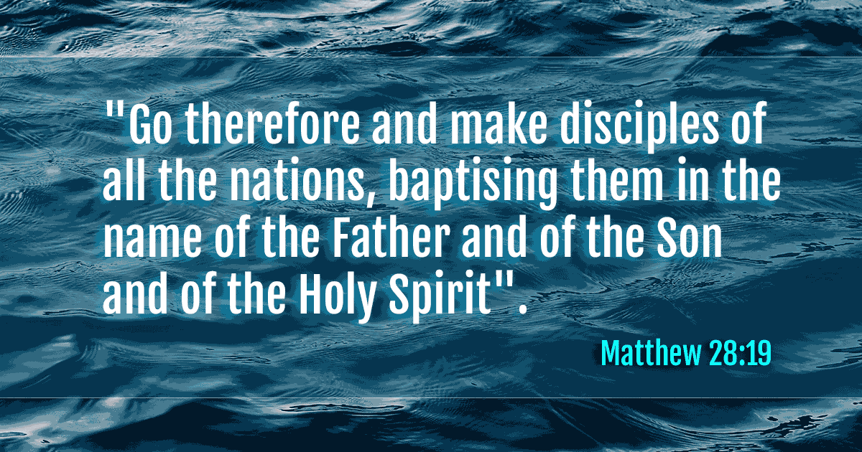
A NOTE FOR DISCIPL MAKERS

Slide 5
MATTHEW 28:19
DISCIPLESHIP IS THE PRIMARY GOAL OF CHRISTIANS
“The disciples path series is a simple tool, no for making disciples but for enabling all of us to take hold of and obey Jesus’ great, enduring commission.”

Slide 6
WHAT IS A DISCIPLE?
ONE WHO HAS CHOSEN TO FOLLOW JESUS
HIS COMMAND TO HIS FIRST RECRUITS WERE FOLLOW ME
LUKE 6:40 The student is not above the teacher, but everyone who is fully trained will be like their teacher.

Slide 7

1 John 3:1 See what great love the Father has lavished on us, that we should be called children of God! And that is what we are! The reason the world does not know us is that it did not know him.
A CHILD OF GOD
1 Peter 2:11 Dear friends, I urge you, as foreigners and exiles, to abstain from sinful desires, which wage war against your soul.
AN ALIEN IN THIS WORLD
2 Cor. 5:17,20 Therefore, if anyone is in Christ, the new creation has come: The old has gone, the new is here! (20) We are therefore Christ’s ambassadors, as though God were making his appeal through us. We implore you on Christ’s behalf: Be reconciled to God.
AN AMBASSADOR FOR CHRIST

Slide 8

YOUR SMALL GROUP
GET STARTED
GROUP DISCUSSION
PRAY TOGETHER AND REFLECT ON LESSON SHARED BY PASTOR
  THE STORY (FOLLOW QUESTIONS FOR DISCUSSION)
    KNOW THE STORY
    UNPACK THE STORY
  ENGAGE – GROUP ACTIVITY PROVIDED BY PASTOR

Slide 9
INDIVIDUAL DISCOVERY
WEEKLY ACTIVITIES
WORSHIP
PERSONAL STUDY
APPLICATION (READING PLAN)

Slide 10


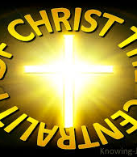
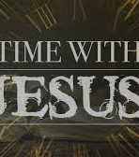
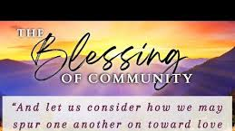
REFLECT:
I have decided to be a Disciple and nothing less for Jesus.
I have decided to have Jesus as the CENTER of my words and my actions.
3. I will continue to COMMIT to the Engagement Exercises and Bible Reading.

Slide 11
June 6, 1944, General Dwight D. Eisenhower sent orders launching what was tagged as D- Day invasion bringing the world to the end of WWII. Until that day, Axis forces held Europe in an iron grip of oppression and tyranny. The situation was grim. The world was waiting. In a similar way, Jesus’ life, death, and resurrection forever changed the course of human history. Although Jesus didn’t use any army to achieve His victory over sin, He did launch the church– and ever-increasing, always-expanding movement of disciples. As a follower of Christ, you’re part of that movement. Therefore, you're called to participate in His continuing mission for the world. That mission contains several different elements, but they can all be boiled down to a core assignment: making disciples of Jesus Christ.

Slide 12
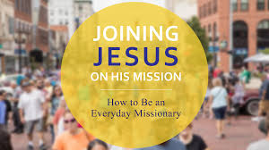
How do you feel about being included as a member of the movement called the church?
What emotions do you experience at the thought telling others about Jesus?

Slide 13
Knowing the Story
The most memorable descriptions of the words of Jesus relating to His mission can be found in what He said first and last to His Disciples.
“Follow Me”
In Session 1 we explored this story from the perspective of choosing to follow Jesus. Now let's focus on the larger mission for the world:
Matthew 4:18-20 “As Jesus was walking beside the Sea of Galilee, he saw two brothers, Simon called Peter and his brother Andrew. They were casting a net into the lake, for they were fishermen. ¹⁹ “Come, follow me,” Jesus said, “and I will send you out to fish for people.” ²⁰ At once they left their nets and followed him.”
The Mission is as Simple as Two Phrases
1. “Follow Me”
2. “Fish for People”

Slide 14
Journal what you have learned thus far about the process of following Jesus? Of fishing for people?
SESSION 1 WHAT JUST HAPPENED – The Invite from Jesus
SESSION 2 THE CENTRALITY OF CHRIST – Very Important
SESSION 3 TIME WITH JESUS- Very necessary
SESSION 4 THE BLESSING OF COMMUNITY – Enlightening
SESSION 5 JOINING JESUS ON MISSION- A Deeper Perspective

Slide 15
Know the Story Cont. After His death, Jesus confirmed and expanded His mission during one of His final conversations with the disciples.
Then Jesus came to them and said, “All authority in heaven and on earth has been given to me. ¹⁹ Therefore go and make disciples of all nations, baptizing them in the name of the Father and of the Son and of the Holy Spirit, ²⁰ and teaching them to obey everything I have commanded you. And surely, I am with you always, to the very end of the age.”
QUESTION: How confident do you feel about obeying Jesus’ commands in these verses? Why?

Slide 16
Unpacking the Story – My Mission is from Jesus Himself “to the end of the age”
How does it make you feel (emotions) just to think about the responsibility of making disciples
How do you respond to Jesus’ claim of authority?
18-Then Jesus came to them and said, “All authority in heaven and on earth has been given to me.

Slide 17
The Core of the Mission: “Make Disciples”
Vs. 19 “¹⁹ Therefore go and make disciples of all nations ….”
How do we ..? What do we..? Where do we start..?
Go: (no room for being passive) to family members, friends, the community, and even throughout the world.
Baptize: make public declarations of faith in Jesus Christ (Baptize them, not get them to become members of the local church, or even to stop sinning, but to proclaim the good news of Jesus Christ and help others confess Him.)
Teach: this is the process of making disciples which does not end at conversion

Slide 18
Go: Baptize: Teach
Which of the above steps seems the most difficult to you? Why?
How have you experienced the process of discipleship in your journey as a follower of Christ?
Know and remember discipleship is a process that takes time and patience Don’t be to hard on yourself

Slide 19
The power of testimony is the idea that sharing a personal story of faith can inspire hope, encourage others, and motivate people to act righteously.
How would you describe your life before you encountered Jesus?
How did you come to know and follow Jesus?
What changes have you experienced since becoming a disciple of Jesus?

Slide 20

1. Bible Reading Mark 13 – Mark 16
2. Pray Daily
3. Spend some real time making a list of different people in your life who need to hear the message of the gospel and experience salvation. Think of as many people as you can and pray that God would make Himself known to that person, and that he or she would experience salvation through Jesus Christ
My List:

Slide 21

Our Mission Is For The World
Acts 1:7-9 He said to them: “It is not for you to know the times or dates the Father has set by his own authority. ⁸ But you will receive power when the Holy Spirit comes on you; and you will be my witnesses in Jerusalem, and in all Judea and Samaria, and to the ends of the earth.” ⁹ After he said this, he was taken up before their very eyes, and a cloud hid him from their sight.
Do you see the connection between these verses and the great commission in Matthew 28:18-20?
The Places: (Jerusalem , all Judea and Samaria)
Home – We should start with family and friends.
A Broader Region – We should THEN witness to the community.
The ends of the Earth – World Missions which often require “COMMUNITY” PARTNERSHIPS.

Slide 22
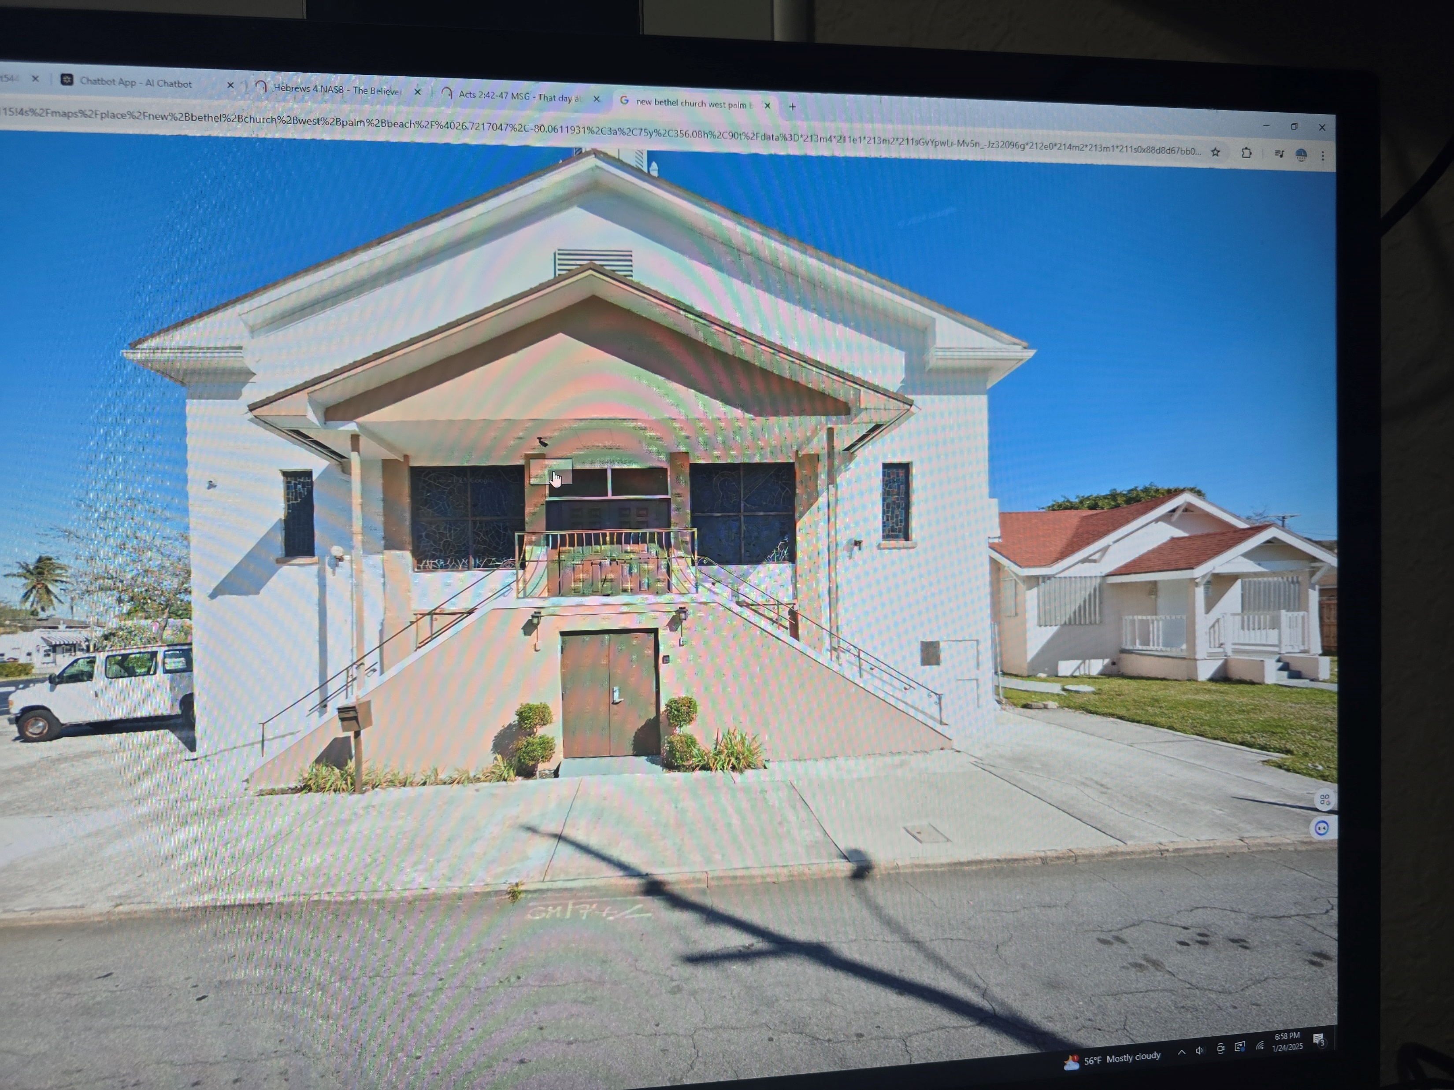
My Mission Includes the Church
Romans 12:4-8 For just as each of us has one body with many members, and these members do not all have the same function, ⁵ so in Christ we, though many, form one body, and each member belongs to all the others. ⁶ We have different gifts, according to the grace given to each of us. If your gift is prophesying, then prophesy in accordance with your faith; ⁷ if it is serving, then serve; if it is teaching, then teach; ⁸ if it is to encourage, then give encouragement; if it is giving, then give generously; if it is to lead, do it diligently; if it is to show mercy, do it cheerfully.

